Slide 1

Medical University Management System
Vrushank Hiremath – 002926888
Sai Sumana Puppala – 02925158
Kavyashree Upendra – 002921251

Slide 2
Problem and Solution
The main challenge is reducing the organization's expenditures while maintaining and providing a superior end-to-end healthcare platform that benefits both students and patients.
There is a tremendous technological defeat in the healthcare business, healthy communities rely on healthy ecosystems, but with growing healthcare costs, it's becoming increasingly impossible for everyone to afford it.
As a result, this platform will assist patients in saving money while also assisting studies in learning through case studies under the supervision of a doctor/professor.

Slide 3
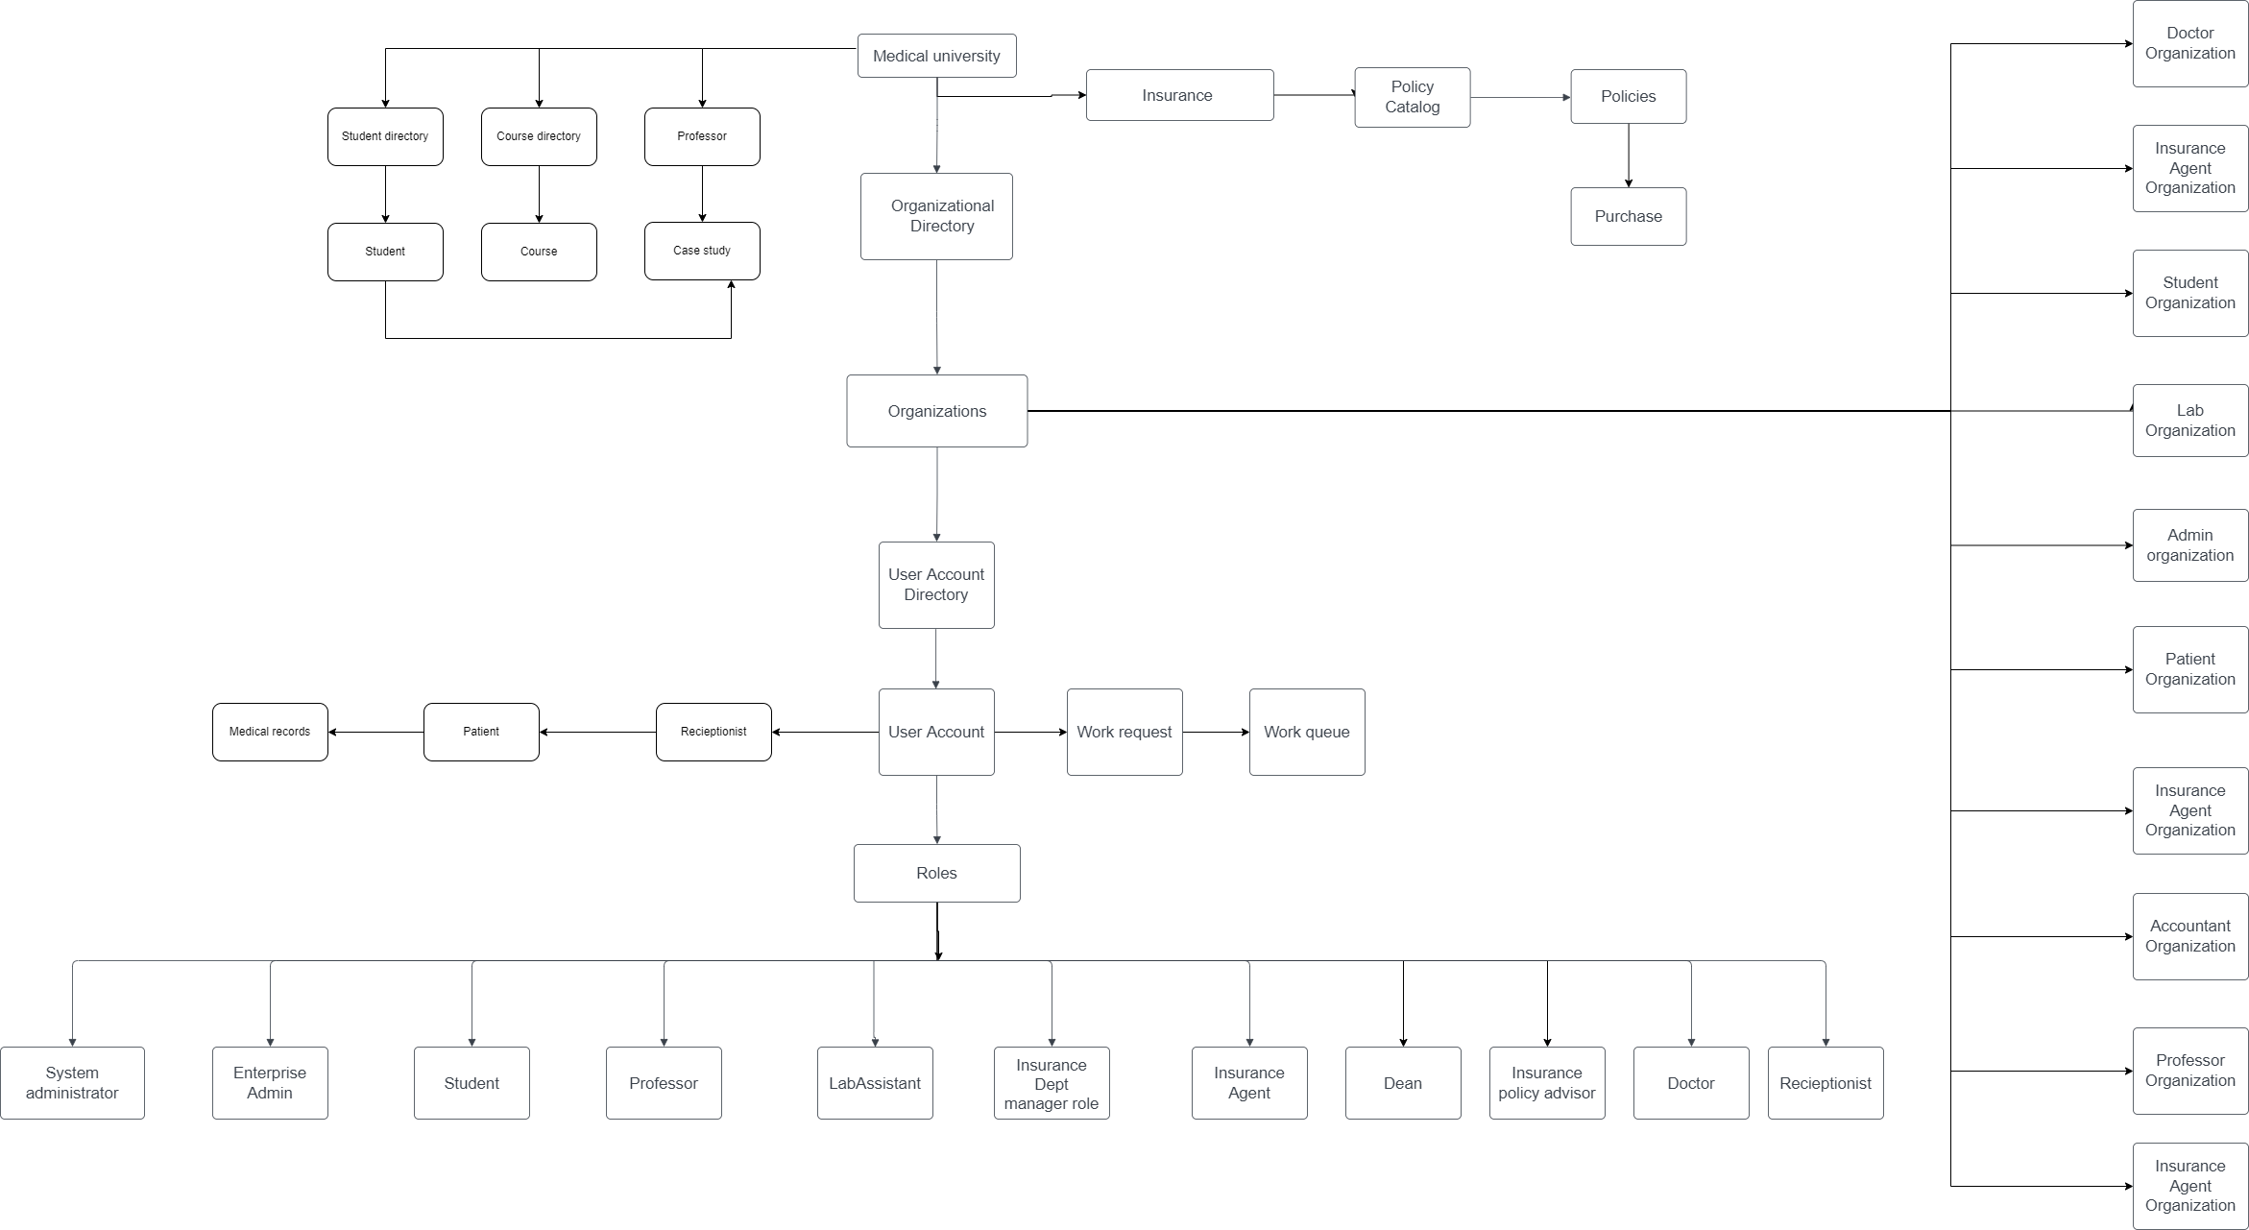
Object Model

Slide 4

Roles

Slide 5
Major Roles
System Administrator - Manage and organize number of enterprises to keep track of multiple operations that takes place in the given environment.
Enterprise Admin - Organize and manage number of businesses and their employees to keep track of various actions carried out in a specific environment.
Doctor - Doctor sends in a request to student for assistance on patient case study, to provide clinical decision points as part of the experiential learning objective associated with the medical university
Student - Student gets a student assistantship request from doctor, he requests Professor to get approval to work on the case study request. Once the professor has approved the case study, the student may begin working on it and, he provides his observations to the assigned doctor, who can use the information to recommend appropriate drugs or procedures to the patients.
Professor - Professor approves student to work on a case study(patient) based on the relevance of student's medical practice to the case.

Slide 6
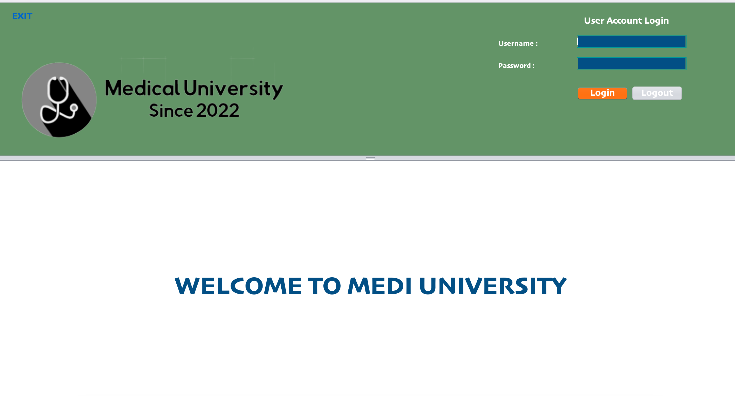

Slide 7
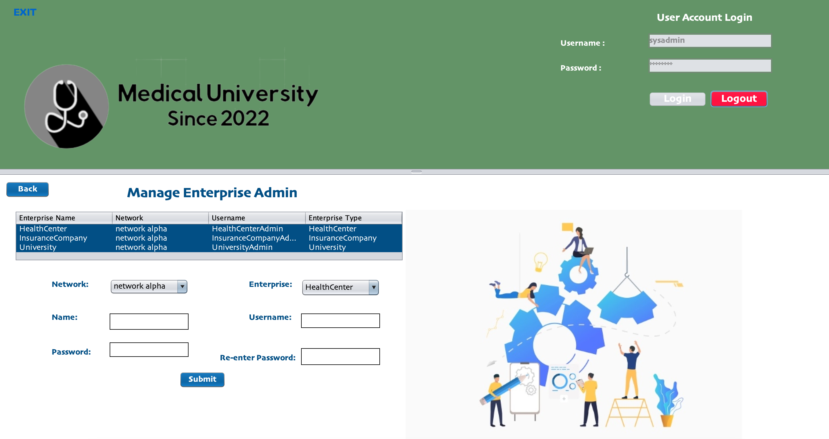

Slide 8
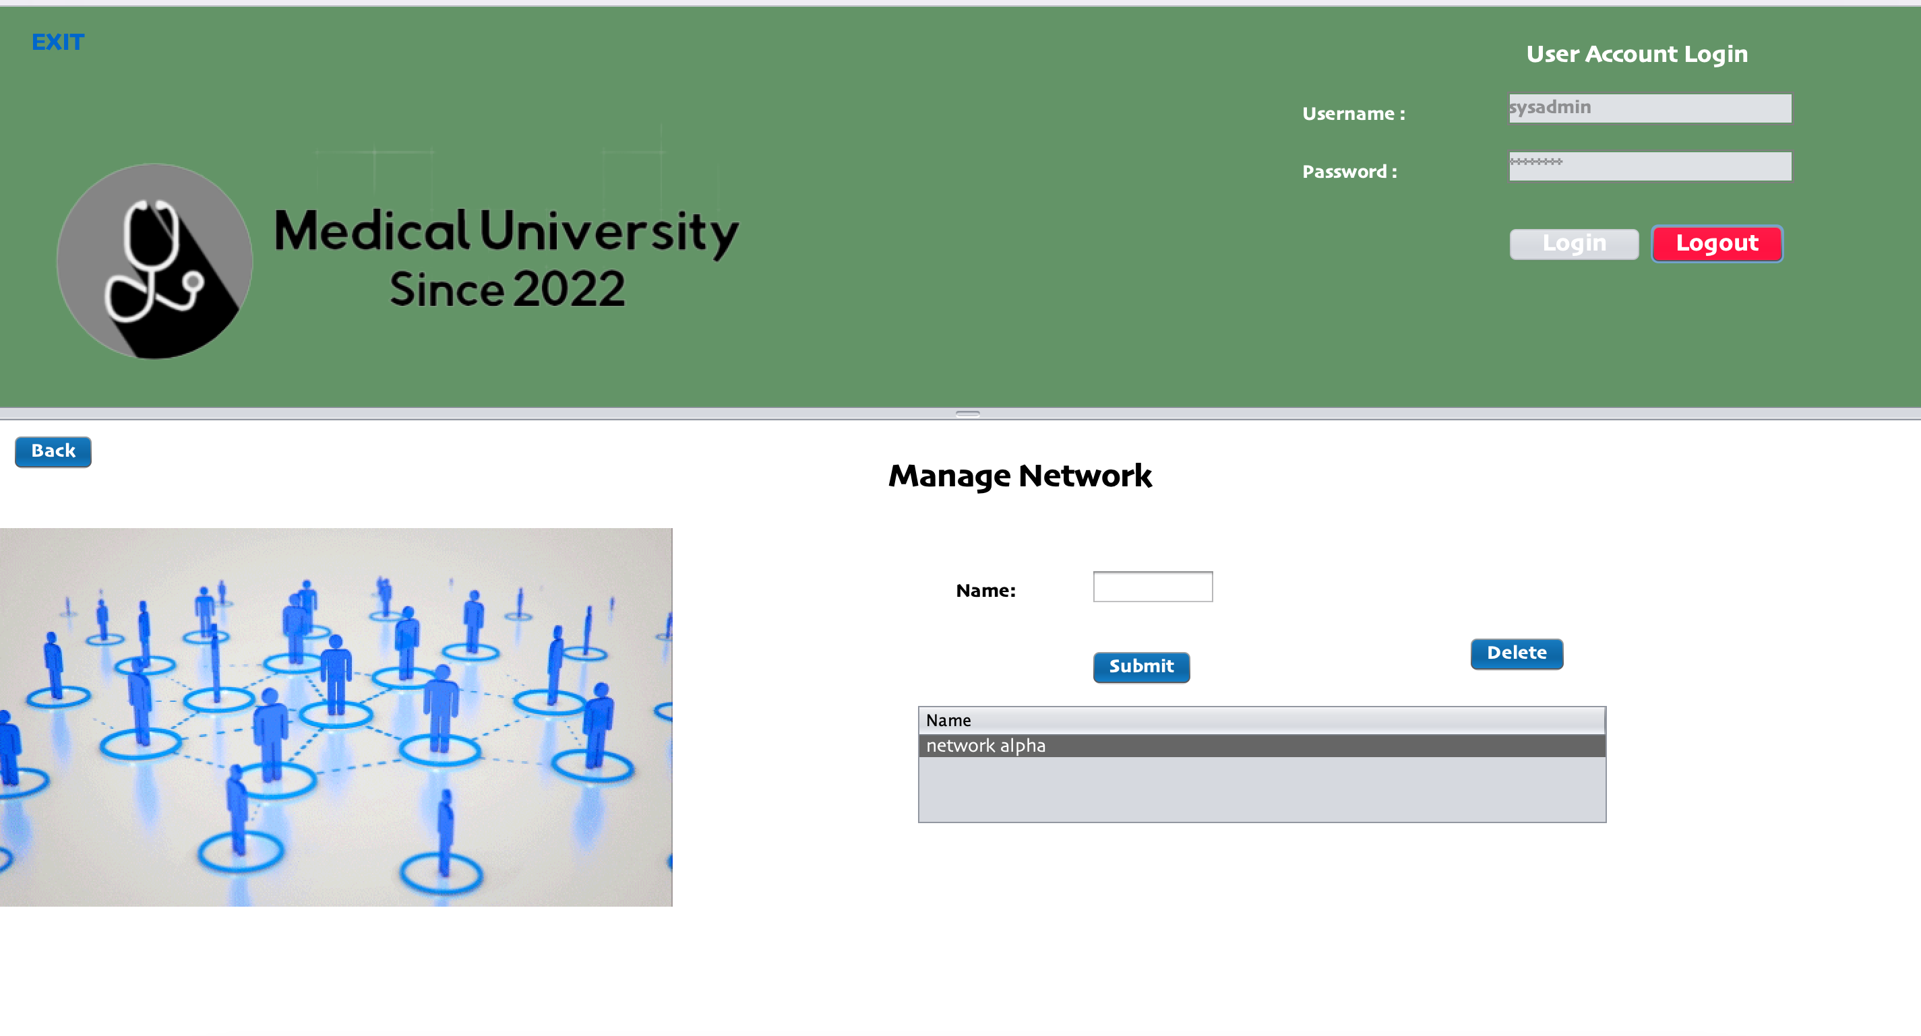

Slide 9
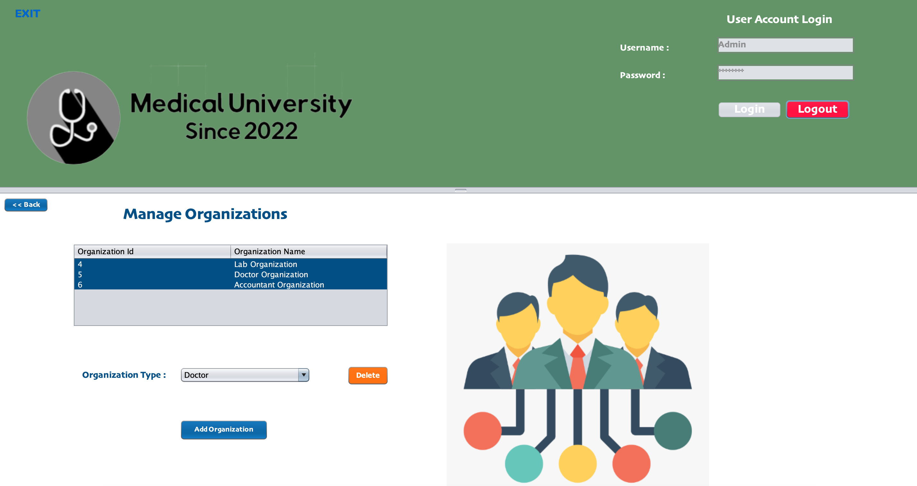

Slide 10
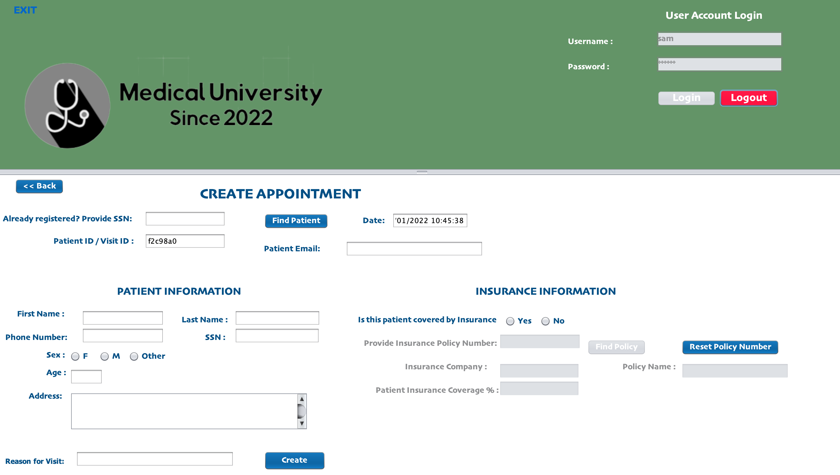

Slide 11
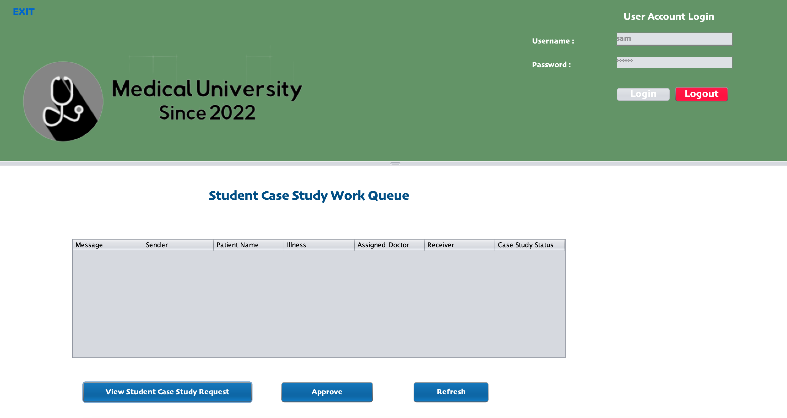

Slide 12
Conclusion
Students can provide value by obtaining detailed patient histories, identifying unwell patients at the point of service, and participating in case studies. This collaborative work will help to positively impact clinical care and medical education.

Slide 13
THANK YOU

